Slide 1

PPIT Final Project Improving Self-Motivation
Kyle Walker - W0263439
ICOM2702

Slide 2

Introduction
The purpose of this project was to improve my self-motivational skills, particularly in relation to maintaining focus on daily tasks, completing personal development goals, and building consistent habits that contribute to my long-term objectives

Slide 3
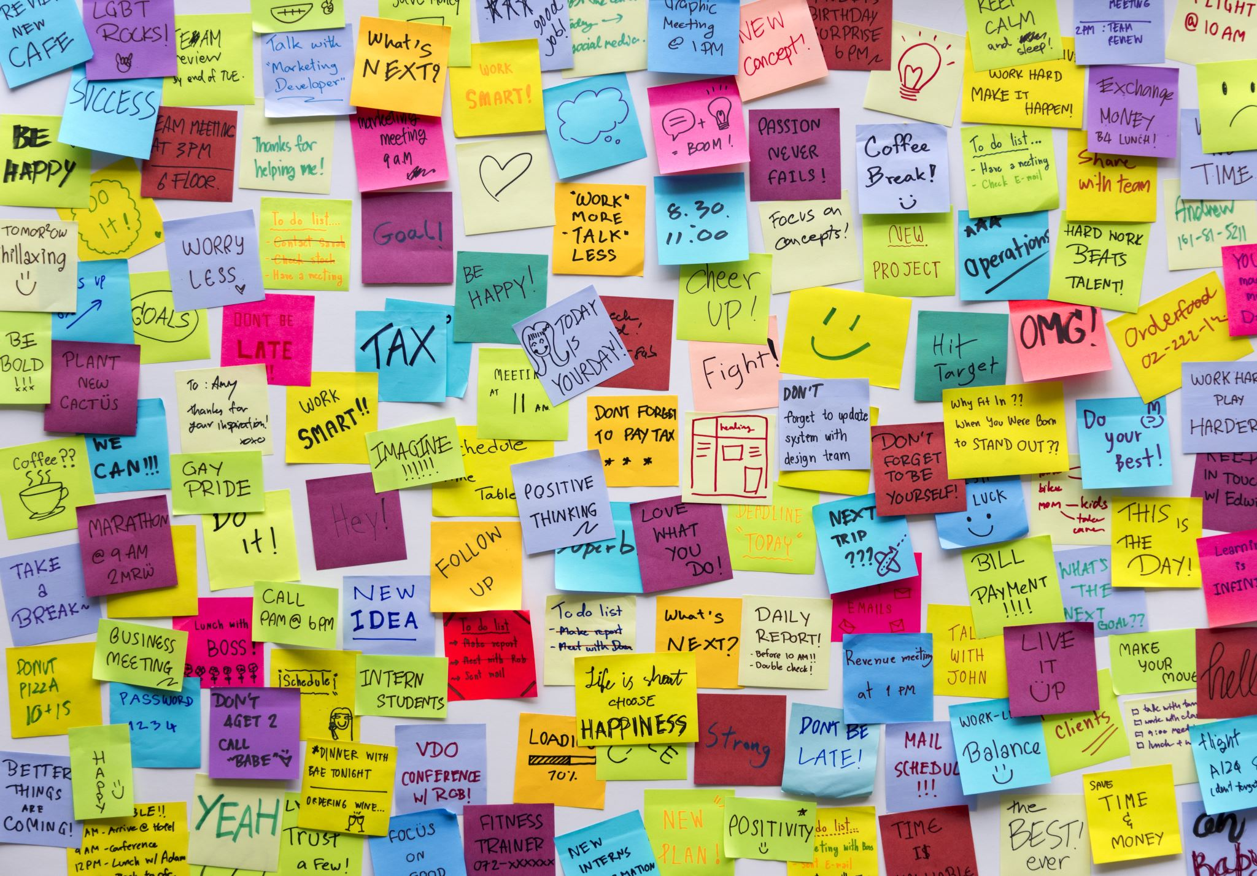
SMART Goal
Goal Statement: To enhance my self-motivation skills by consistently implementing daily tasks and weekly objectives, focusing on forming habits that support long-term growth, with measurable improvement by November 12th, 2024.
SMART Goal Breakdown:
Specific: I aimed to set and complete daily and weekly personal goals.
Measurable: I tracked my motivation levels and task completion rate weekly.
Achievable: The project was designed to fit within my current schedule.
Relevant: Improving self-motivation is critical for professional growth and personal productivity.
Time-Bound: One month, with progress checks weekly and a final evaluation by November 12th, 2024

Slide 4
Description of Current State
Prior to the start of this project, I struggled with consistent motivation for personal projects, often feeling unmotivated after work or at times when external deadlines were lacking. My baseline included fluctuating productivity levels, especially on non-essential personal goals.

Slide 5

Current State Baseline Measure
I measured my initial state by evaluating:
Daily Completion Rate: Percentage of personal tasks completed per day.
Weekly Motivation Score: Rated from 1 to 10 at the end of each week to self-assess my motivational levels.
Baseline Data (Average):
Daily Completion Rate: 60%
Weekly Motivation Score: 5/10

Slide 6

Target State Description
The desired outcome was to raise my daily task completion rate to 85% and increase my weekly motivation score to at least 8/10 by consistently using techniques to boost self-motivation, such as positive reinforcement, journaling, and structured breaks.

Slide 7
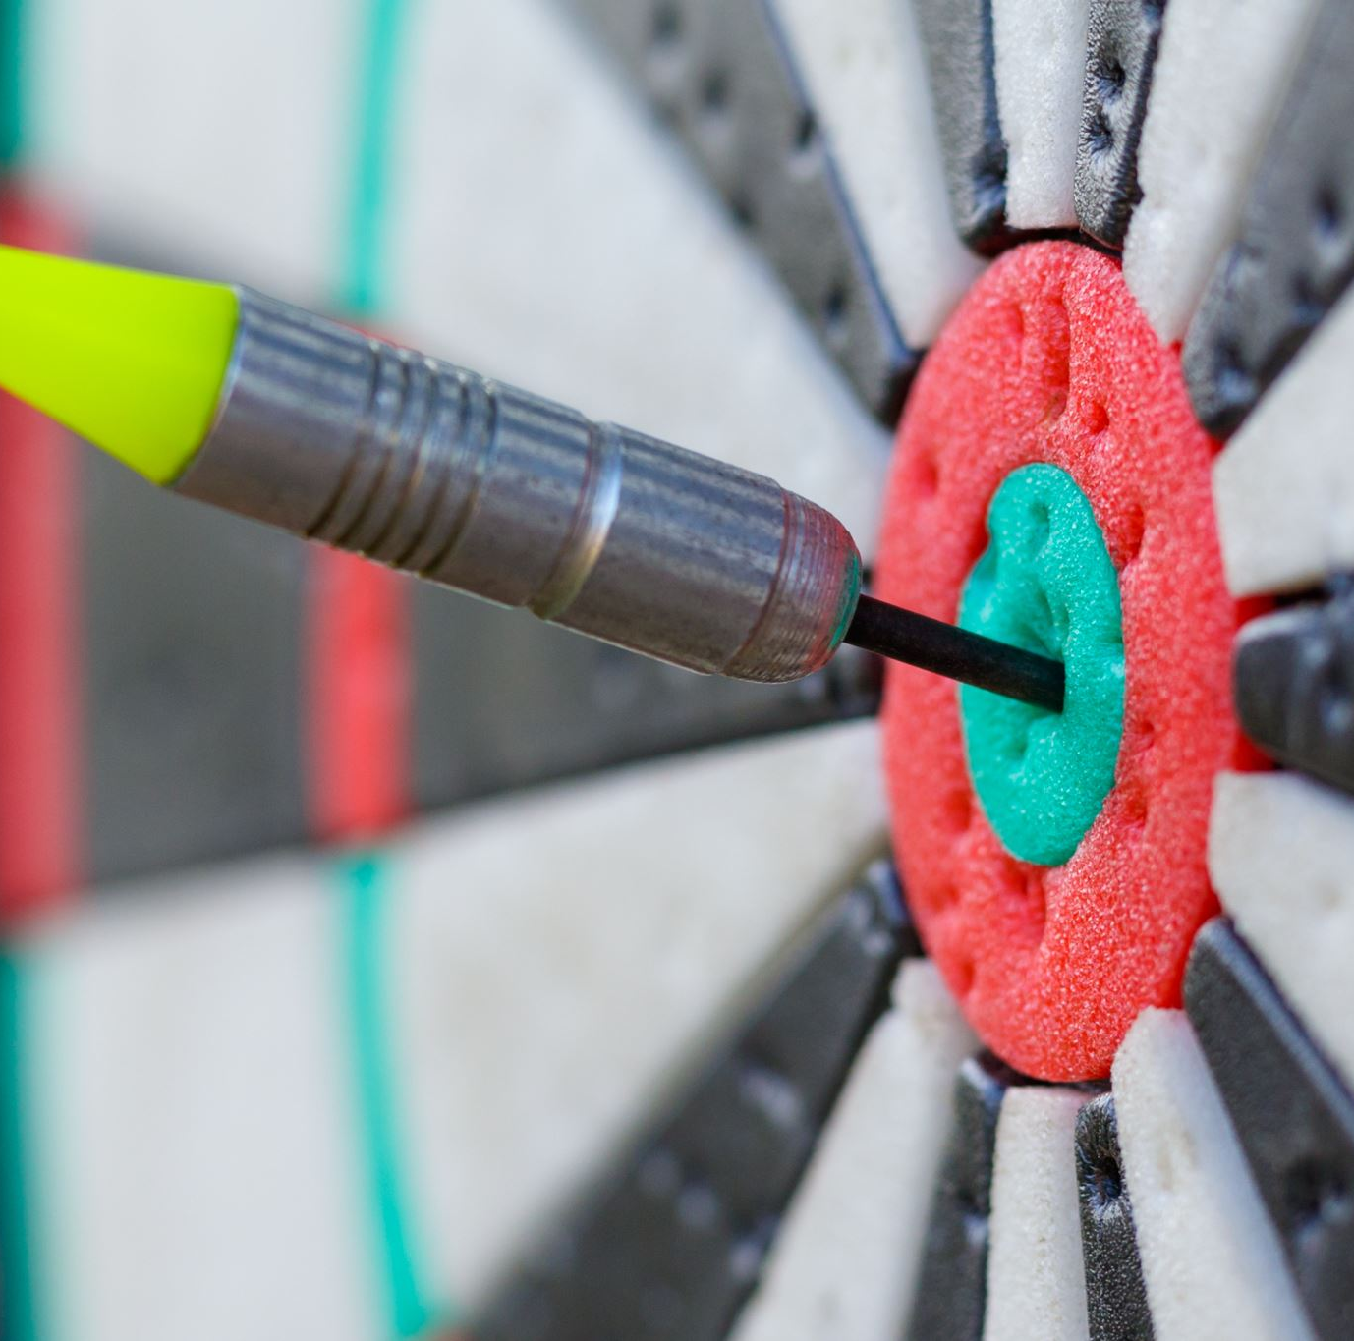
Target State Measure
Target Measures:
Daily Completion Rate: 85% of tasks completed.
Weekly Motivation Score: 8/10 consistently by the end of the month.

Slide 8

Methodology
To accomplish my goals, I used the following resources and techniques:
Reading: Books and articles on motivation techniques.
Practice: Daily goal-setting and end-of-day reflection.
Journaling: Documenting daily progress, challenges, and motivational levels.
Mindfulness Exercises: Short meditation sessions focused on building focus and resilience.
Visualization Techniques: Setting mental images of success to maintain drive.

Slide 9
Six-Week Schedule of Activities
Week | Date Range | Activities
1 | Oct 12 - Oct 18 | Baseline setting, establish daily goal habits, begin journal
2 | Oct 19 - Oct 25 | Increase task difficulty, introduce visualization exercises
3 | Oct 26 - Nov 1 | Reflect on challenges, adjust techniques, start mindfulness
4 | Nov 2 - Nov 8 | Focus on consistency, increase goal complexity
5 | Nov 9 - Nov 15 | Re-evaluate, introduce weekly review for reflection
6 | Nov 16 - Nov 12 | Final push, reflect on progress, identify key successes

Slide 10
Performance Data
Week | Daily Completion Rate (%) | Weekly Motivation Score (1-10)
1 | 65% | 6
2 | 69% | 6.5
3 | 73% | 7
4 | 82% | 8
5 | 85% | 8.5
6 | 88% | 9

Slide 11

Summary of Activities
Throughout the project, I consistently journaled my progress, practiced visualization, and completed daily tasks

Slide 12
Analysis
Insights Gained: I learned that self-motivation improves significantly with consistent practice and reflection.
Areas for Improvement: For future improvement, I would introduce more varied motivational techniques sooner, such as pairing tasks with small rewards and exploring new ways to stay engaged
Professional Impact: This project sharpened my time-management skills and taught me resilience techniques valuable in both personal and professional contexts

Slide 13
Conclusion
The self-motivation project was highly successful in helping me reach my goal of a consistent 85% task completion rate and a motivation score of 8/10 or higher

